Slide 1
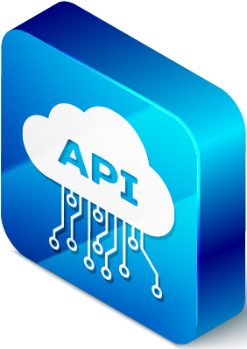
Students Enrollment Website Building the system using Restful APIs

Slide 2
Website Requirements:
1. System should allow applicants to submit their applications on the website.
2. The admission team member assess and retrieves the applicants submission.
3. The admission team member responds to the applicants who have submitted.
4. The applicants is now able retrieve his or her submission
5. The applicants can view the response from the college and see if their applications was accepted or not.

Slide 3
Tools To Be Used:
1.Visual Studio Code – That’s the IDE I choose to use its robust, flexible, compact ,contains a built-in server & Fast.
2. POSTMAN – A popular online & offline tool for testing APIs
3. EXPRESS – A framework for building fast lightweight web applications
4. REST Services – The Restful API services that I will use.
5. NODE - The Runtime environment that my project will run on, its highly scalable, fast and data request & response rate is amazing
6. Coding Language – I Choose JavaScript
7. Mongo DB – This is the NOSQL database system I choose for the project

Slide 4
What is Rest Api & Why Rest?
A standard platform for building an API is REST (Representational State Transfer),
a good starting point for building an API. If you are creating an API to serve
customers across multiple channels (e.g. mobile, desktop, web, social media), REST
provides good abstraction for your APIs. REST is mostly documented and has
been through all the hype cycles such as Web Services Express, SOAP (Structured
Communication Layer Application Programming Interface),

Slide 5
Deconstructing Parts of Rest APIs
VERB | URI (Query string)
HEADERS
REQUEST BODY
As we undertake the trouble of designing an API there’s common factors that we need to take into consideration which includes:
VERB : This is the indicator of what my intention is in regard to the URI that’s going to be used. GET,Post , Put & Delete are some of the most widely used http requests known as verbs.
Uri: it’s the path on the webserver this means that this is the path that my web project will use to connect to the server, simply put URIs are paths to resources

Slide 6
example: http://localhost/api/students
Headers : As you design your API you need to also consider headers if you are going to use headers if your clients will use headers or need to be able to read
Headers
Body: Another consideration to look into is the request body if there’s any.
STATUS CODE:
What sort of response is going to be sent back to say that it succeeded or failed or how it’s going to fail.
STATUS CODE

Slide 7
case Study: http://localhost/api/student
Client
Server
HTTP
Using http://localhost/api/student as our case study or user case its actually important to stress that the /student part of the Url represent or is called a resource endpoint
We can expose our resources such as applicant’s(student) name , surname , race, gender, age, selected course and various endpoints
What are Resources ? They can be viewed as nouns that we want to expose through the API, we can also define resources as something inside of a context , it may be that individual people are a type of resource but a resource can be an invoice & that invoice is more complicated it mite the invoice itself and all items that are contained in the invoice this complex object in particular is still considered a single resource.

Slide 8
CContext
The Resources
Site
Id ….
Location Id Category Id Region Id
Category
Category Id Name
Region
Region Id Name
-member Name
Location
Location Id Country ….
Site Id

Slide 9
Student applicant Admission team member
Login and Submit the application
Assess and retrieves the applicants submission
Approve or Rejects the applicants submission
Sends a response to applicants
Retrieves the submission and view the response from college.

Slide 10
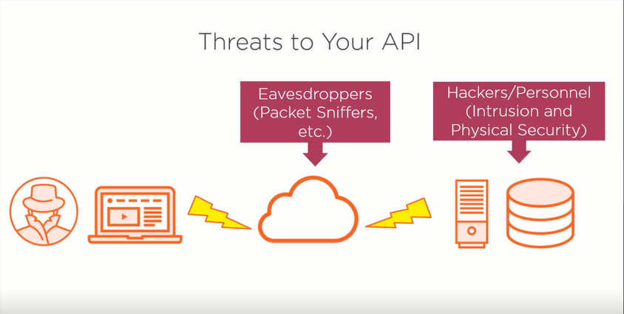
There of course threats to the system that you will be building the API for. When you build a web or mobile app,you’ll likely need to offload work to a third party. A platform service lets you use a service that is managed by the service provider. This is also known as a service bus. The key here is that the service provider has the same level of permissions to access your API as you have.
Platform services are useful if you’re working with a large external provider that you don’t want to open up the API to as part of your private lives.

Slide 11
It allows you to run a service on third-party infrastructure and interact with that service using an API key and gateway. For example, if you work with Airbnb, they may run a service that connects directly to your API in the background,and you interact with it through their platform. If you use a platform service, you have to be very careful with security, as the company you use to host it could have access to a lot more information about your traffic than you do. You also need to make sure that your service provider knows your API key.

